Slide 1
Risk Measures
Ernest Chan, Ph.D.
Week 7 - Predict 451

Slide 2
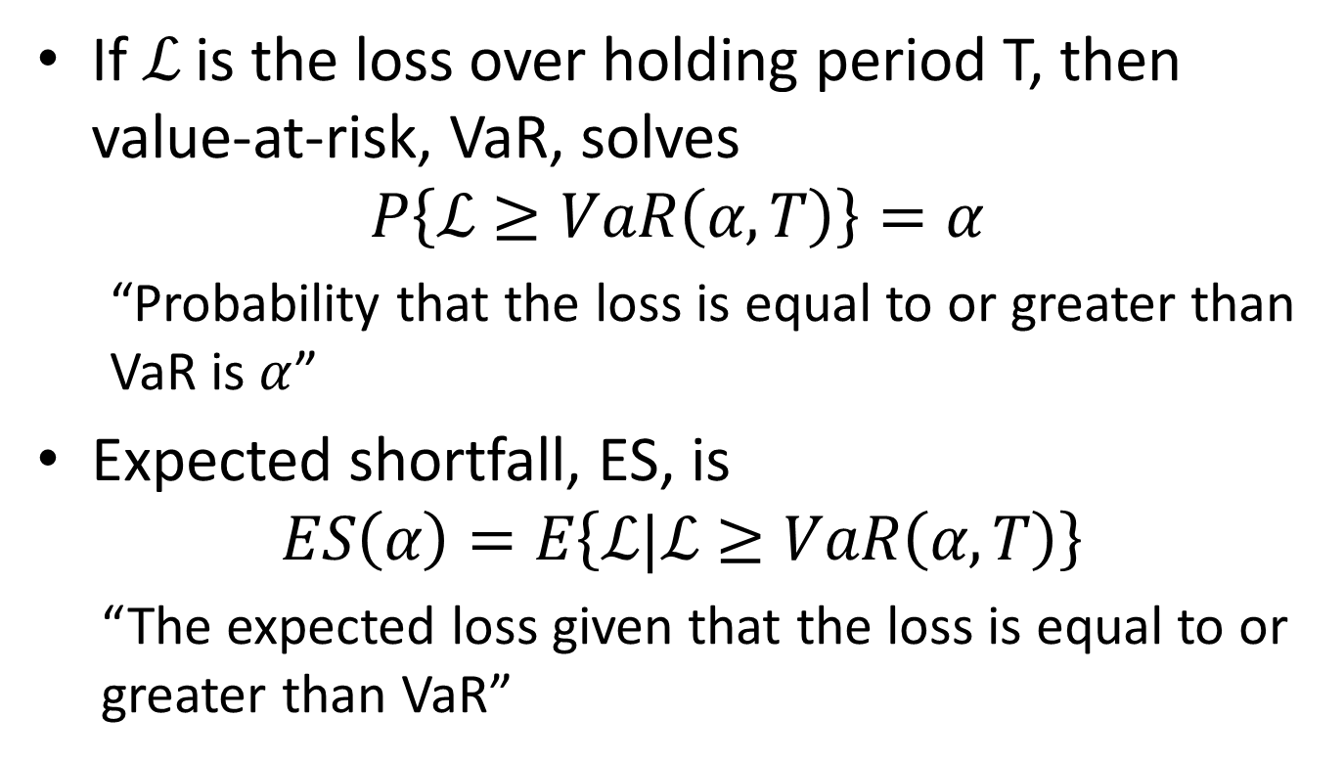
VaR and ES
If $ℒ$ is the loss over holding period T, then value-at-risk, VaR, solves
$$P\left\{ℒ≥VaR\left(α, T\right)\right\}=α$$
“Probability that the loss is equal to or greater than VaR is $α$”
Expected shortfall, ES, is
$$ES\left(α\right)=E\left\{ℒ|ℒ≥VaR\left(α, T\right)\right\}$$
“The expected loss given that the loss is equal to or greater than VaR”
Notes:
Note that VaR differs for different holding period T. Does VaR always increase with T? (If returns are mean-reverting, VaR may decrease with T.)
VaR decreases with $α$ for fixed T.

Slide 3

Computing VaR
If F is the cumulative probability of returns over some period T, and S is the asset market value, then $VaR\left(α\right)$=-S$∙F^{−1}(α)$
Notes:
Can you estimate VaR(0.05) from this graph if S is $1M? Ans. about -$900K.

Slide 4
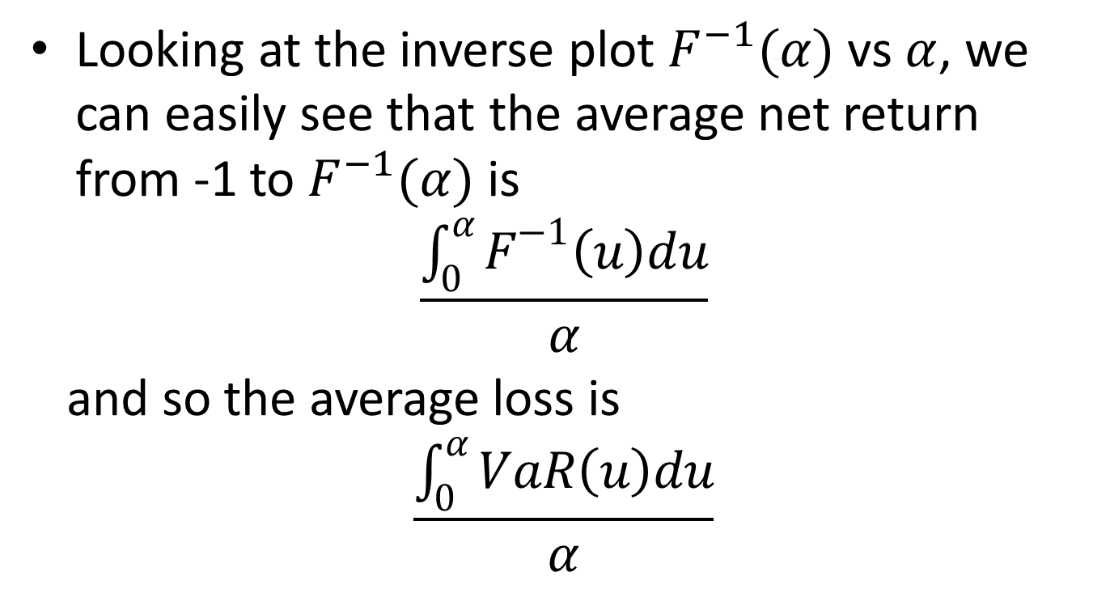
Computing ES
Looking at the inverse plot $F^{−1}(α)$ vs $α$, we can easily see that the average net return from -1 to $F^{−1}(α)$ is
$$\frac{\int_{0}^{α}{F^{−1}\left(u\right)du}}{α}$$
and so the average loss is
$$\frac{\int_{0}^{α}{VaR\left(u\right)du}}{α}$$

